Slide 1


Goal-oriented Workflow using Rstudio
Roxanne beauclair, Phd candidate, mph, ma
icrh, Ghent university
Sacema, stellenbosch university

Slide 2
What is ‘workflow’?
Deciding:
Where to store data?
How to refer to files in a script?
How to run scripts?
How to produce and collect report results?

Slide 3
Goals of your workflow
Transparency: organizes the components of a project logically, making it easy for other observers to understand how everything fits together
Maintainability: facilitates easy modification and adaptation of the project.
Modularity: Discrete tasks are separated into components (scripts), so it is clear where modifications need to be made.
Portability: Makes it easy to move the project to another system or hand over to another person
Reproduciblity: You and others should be able to reproduce the results
Efficiency: The workflow should save you time buy making it easier to debut, and automating as much of the process as possible

Slide 4
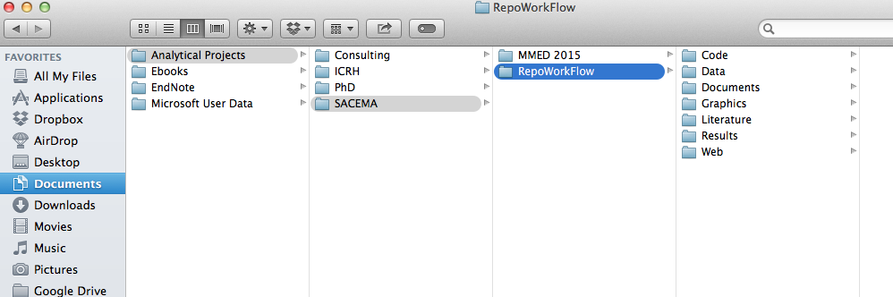
Organize your project
Good directory structure
Store all project-related files in one folder on hard-drive
Sub-directories for different aspects of the project

Slide 5
Directory structure in more detail
/Data
/Raw data
/Cleaned data
/Code
/Scripts
/Rmarkdown
/Do files
/Graphics
Saved plots as PNG or PDF
/Results
Html reports
Latex for word documents with outputs of data aggregation
/Documents
/Manusctipts
/Presentation Slides
/Literature
Key papers relevant to this particular project
/Web
Holds content for web site
Read-only
Modifiable,
Can be easily re-generated with code

Slide 6
/Code Folder
/Code
/Scripts
Importing raw data
Cleaning/fixing data
Exclusions
Any other transformations of dataset
Creating new variables
Imputation for missing data
Analysis
Functions
Tables and figures for final manuscript
Transparency

Slide 7
Version Control
Multiple people can work on one project, simultaneously without getting 'conflicted copies’
Access to historical versions of the file before different edits were made
Undo specific edits without loosing all work that has been done previously → Encourages experimentation
At any point in time you can see who made what edits and when
Facilitates backup
Reproducibility

Slide 8
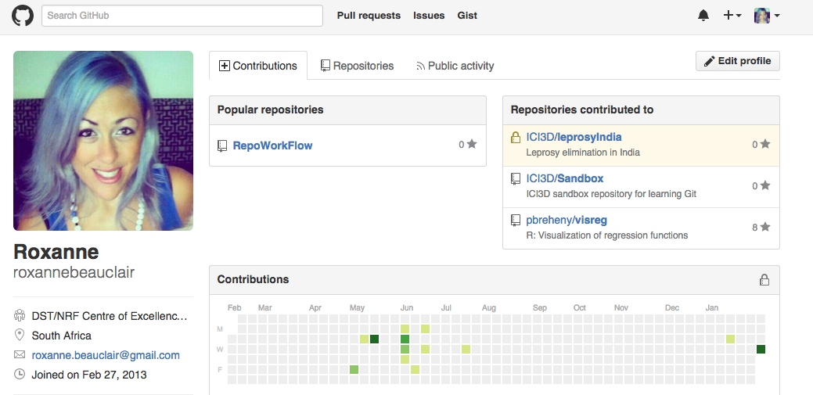
What is Git?
Git is an open source version control system that offers source code management
GitHub is a web-based Git repository hosting service

Slide 9
Basic Git Commands Chart
Web Interface
Repository
(On GitHub)
Clone
Pull
Commit
Local Repository
Push

Slide 10
Directions for Adding Git to the Workflow
1. Make sure your folder directory is set up in an organized way
2. Set up GitHub account (https://github.com), including your profile
3. Download and install platform-specific versions of a Git client app
I use SmartGit
Works on Linux, Windows, and Mac OS’s
User friendly
This will be used to push and pull files between the local repository and GitHub
4. Configure Git with global commands in your terminal.
git config --global user.name “your GitHub account name”
git config --global user.email “email address registered with GitHub”

Slide 11
Git Directions Continued
5. Open Rstudio and set the path for the Git executable
Tools > Global Options > Git/SVN
It should auto-populate the location, then click ‘Ok’.
6. Restart Rstudio
7. Initialize new repository on GitHub
8. Go back to Rstudio and create a new project
Create project > Version Control > Git > Past URL from repository on Git Hub > and select the location of the local subdirectory
I used Analytical Projects/RepoWorkFlow

Slide 12
Quick Side Note about ‘Projects’ in Rstudio
Allows you to divide work into different contexts, each having its own working directory, workspace, history and source documents.
Can be created:
In a brand new directory
In an existing directory
By cloning a version control repository
When a project is created:
Creates project file
Creates hidden directory
Loads project into Rstudio
No need to set your working directory in scripts, making relative paths easier!
Portability

Slide 13
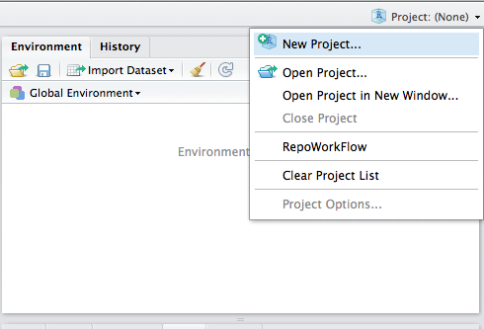
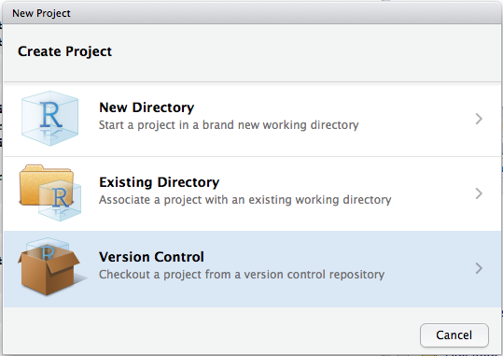
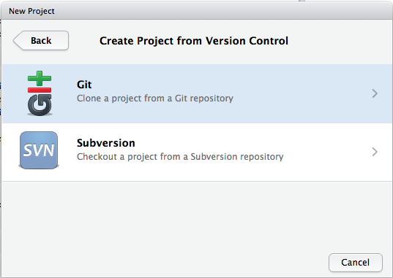
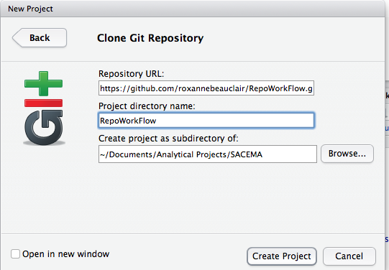

2
1
4
3

Slide 14
Git Directions Continued
9. Now do some work in Rstudio, create and save files in our local directory which is now linked to GitHub.
10. Go to your local git client, view modified files, commit and push them to GitHub.

Slide 15
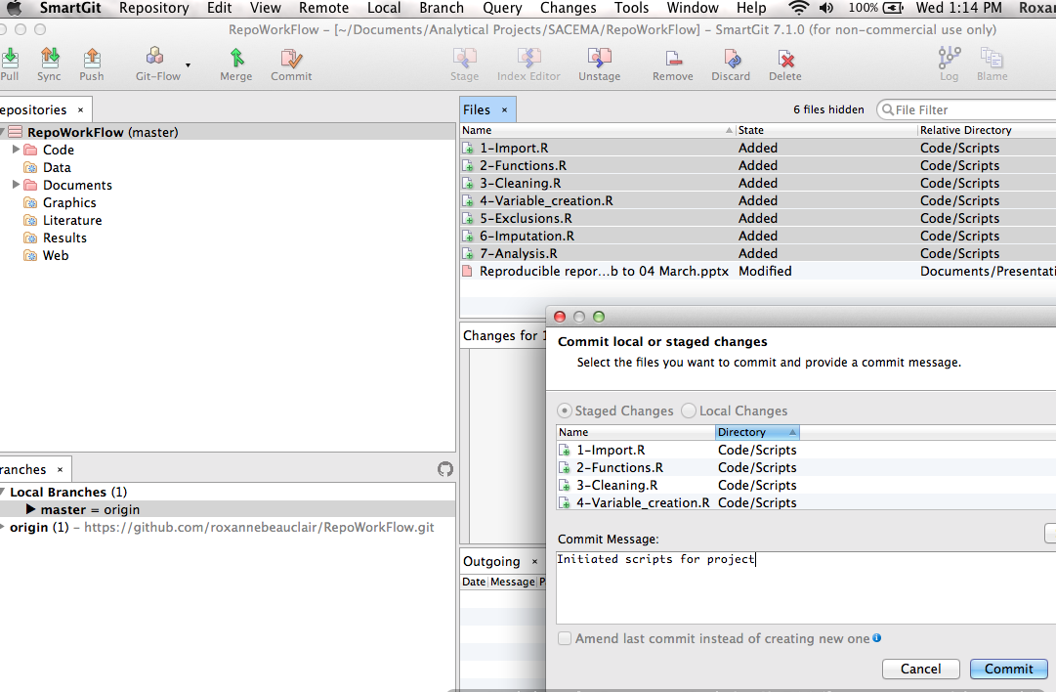

Slide 16
Helpful websites for this process
http://www.molecularecologist.com/2013/11/using-github-with-r-and-rstudio/
https://support.rstudio.com/hc/en-us/articles/200532077-Version-Control-with-Git-and-SVN
How to use SmartGit
https://www.youtube.com/watch?v=gB8OmhRJ0D8

Slide 17
Good Style
Rule of transparency
“Good coding style is lke using correct punctuation. You can manage without it, but it sure makes things easier to read.”
—Hadley Wickham

Slide 18
R Style Guide
Transparency
The goal of using a style guide is to make R code easier to read, share, and debug
Focus on what is being said, not how it is being said
Most of the rules were designed by the R user community at Google
Hadley Wickham has also published his own style guide which is very similar to Google’s
The following rules are mostly agreed upon by Hadley and Google
The most important thing is for you to agree upon conventions with your collaborators and then be consistent.

Slide 19
Indentation and line lengths
Limit code to 80 characters per line
If you run out of room, good idea to put some of that code in a separate function or object
When indenting:
Use 2 spaces
Exception: when line break occurs inside ( ), align wrapped line with 1st character inside ()
Never use tabs
Exception: when function definition runs over several lines

Slide 20
Spacing
Place spaces around all operators (=, +, -, <-, etc.). The same rule applies when using = in function calls. Always put a space after a comma, and never before.
There’s a small exception to this rule: :, :: and ::: don’t need spaces around them.
Extra spacing (i.e., more than one space in a row) is ok if it improves alignment of equal signs or assignments (<-).
Don’t place spaces around code in parentheses or square brackets (unless there’s a comma, in which case see above).

Slide 21
Curly braces
An opening curly brace should never go on its own line and should always be followed by a new line. A closing curly brace should always go on its own line, unless it’s followed by else.
Always indent the code inside curly braces.
It’s ok to leave very short statements on the same line

Slide 22
Conventions for naming files
File names should be meaningful and end in .R.
If files need to be run in sequence, prefix them with numbers

Slide 23
Conventions for naming variables
All letters should be lowercase.
Use an underscore or period ( _ / . ) to separate words within a name.
Google (and Roxy) prefers ‘.’
Hadley prefers ‘_’
Should be nouns
Strive for names that are concise and meaningful
Never name a variable T or F

Slide 24
Conventions for naming functions
Avoid using names of existing functions and variables. This will cause confusion for the readers of your code.
Names should be verbs
Camel case is the proper convention
First letter of first word is lowercase, while following words start with upper case letters
E.g. change.dates( ) is bad, while changeDates( ) is good

Slide 25
A note on data cleaning
Labelling all variables in your ‘clean dataset’ is very important (requires library memisc)!
description() : short description of the variable, always
wording() : wording of the question, if necessary
labels(): for values of a factor variable
Pro-tip: Label the variables exactly how you would want them to appear in a table for publication. This will save you time later when you automate your reports.
Efficiency

Slide 26
Layout and ordering of code
Copyright statement comment
Author comment
File description comment, including purpose of program, inputs, and outputs
Dependencies
source ( )
library( )
If it is a specialty package remind yourself which functions you are going to use in case you don’t have that package later, or decided you don’t need to use that function later.
Function definitions
Executed statements

Slide 27
Comments at the beginning of each file

Slide 28
Comments at the beginning of each function

Slide 29
Types of documents you can produce
Interactive interfaces between models and results
Shiny
Dynamic reports
Knitr = runs chunks of R code and appends results to parallel document
Pandoc = converts the program to new format
Html
PDF
Word
PDF slide show
Sweave
LaTeX
LyX

Slide 30
RMarkdown

Slide 31
YAML

Slide 32
References
http://www.kirchkamp.de/oekonometrie/pdf/wf-screen2.pdf
http://nicercode.github.io/blog/2013-04-05-projects/
http://journals.plos.org/ploscompbiol/article?id=10.1371/journal.pcbi.1000424
http://www.carlboettiger.info/2012/05/06/research-workflow.html
http://adv-r.had.co.nz/Introduction.html
https://cran.r-project.org/web/packages/rockchalk/vignettes/Rstyle.pdf

